Slide 1
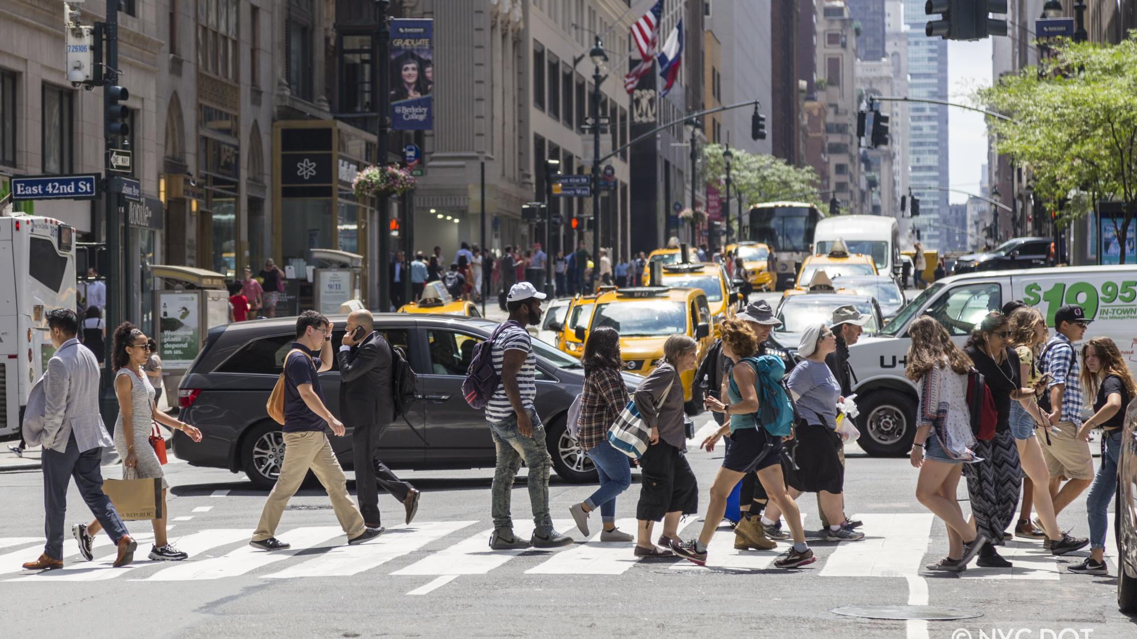
$ 14.7 Billion
Source: Rudin Center for Transportation Policy & Management,NYU

Slide 2
555K
NUMBER OF INJURIES DUE TO CAR ACCIDENTS AFTER 2014
2.6K
NUMBER OF DEATHS DUE TO CAR ACCIDENTS AFTER 2014
3000
NUMBER OF INJURIES THIS YEAR

Slide 3

Vision ZERO
NEW YORK CITY HAS BEEN ON THIS MISSION TO MAKE ROAD ACCIDENT RELATED FATALITIES AND DEATHS TO ZERO

Slide 4

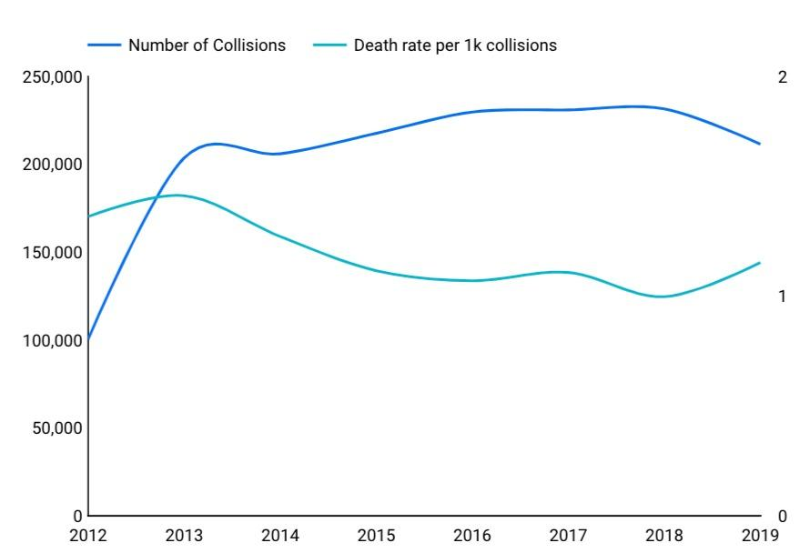
TIME BASED PATTERN FOR COLLISIONS​
Even after the implementation of vision zero, we don't see a significant drop in the number of injuries/deaths

Slide 5
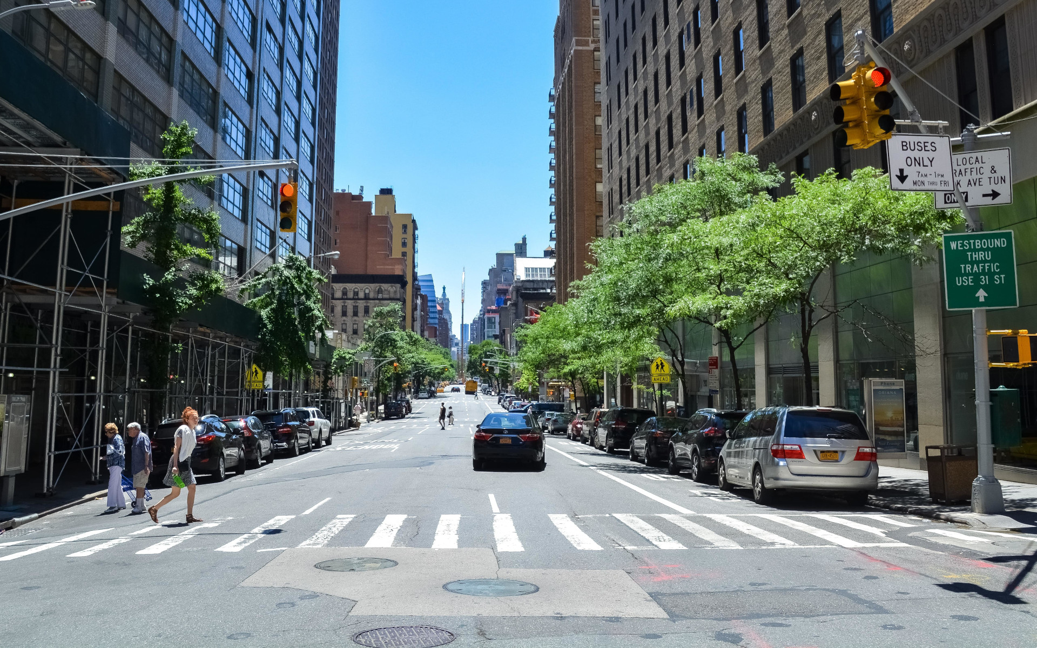
WHY ARE WE TOLERANT TO ROAD RELATED ACCIDENTS?
MISSION : MAKE VISION ZERO A REALITY
MISSION : MAKE VISION ZERO A REALITY

Slide 6




Google Hackathon MBAN 2024
TANMAY AMBRE
CARA ZHOU
DAKSH ARORA
RAHUL DHOMANE
PRESENTED BY: TEAM 06

Slide 7



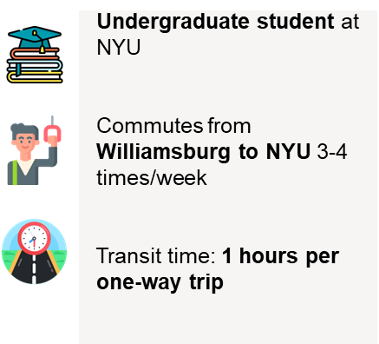

HOW DRIVER'S BEHAVIOR INFLUENCE COLLISIONS ?
Takes a route
with Red zones
PAIN POINTS
Drives to
her school
Tends to take
sharp turns
"Wished somebody
would have told me
about the risks
in this area"
"Wished somebody
would have told
me about the Driver’s
Behavioral pattern"
~Insurance agent
Met with a collision
"What could I have
done to prevent
this collision?"
~City planning
committee
Takes a sharp
Turn

Slide 8
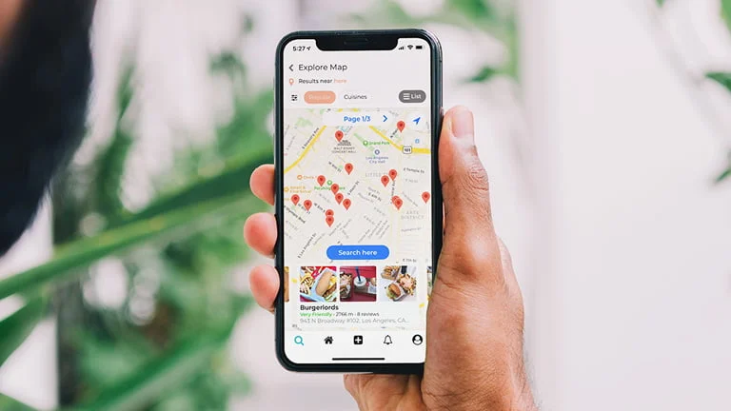
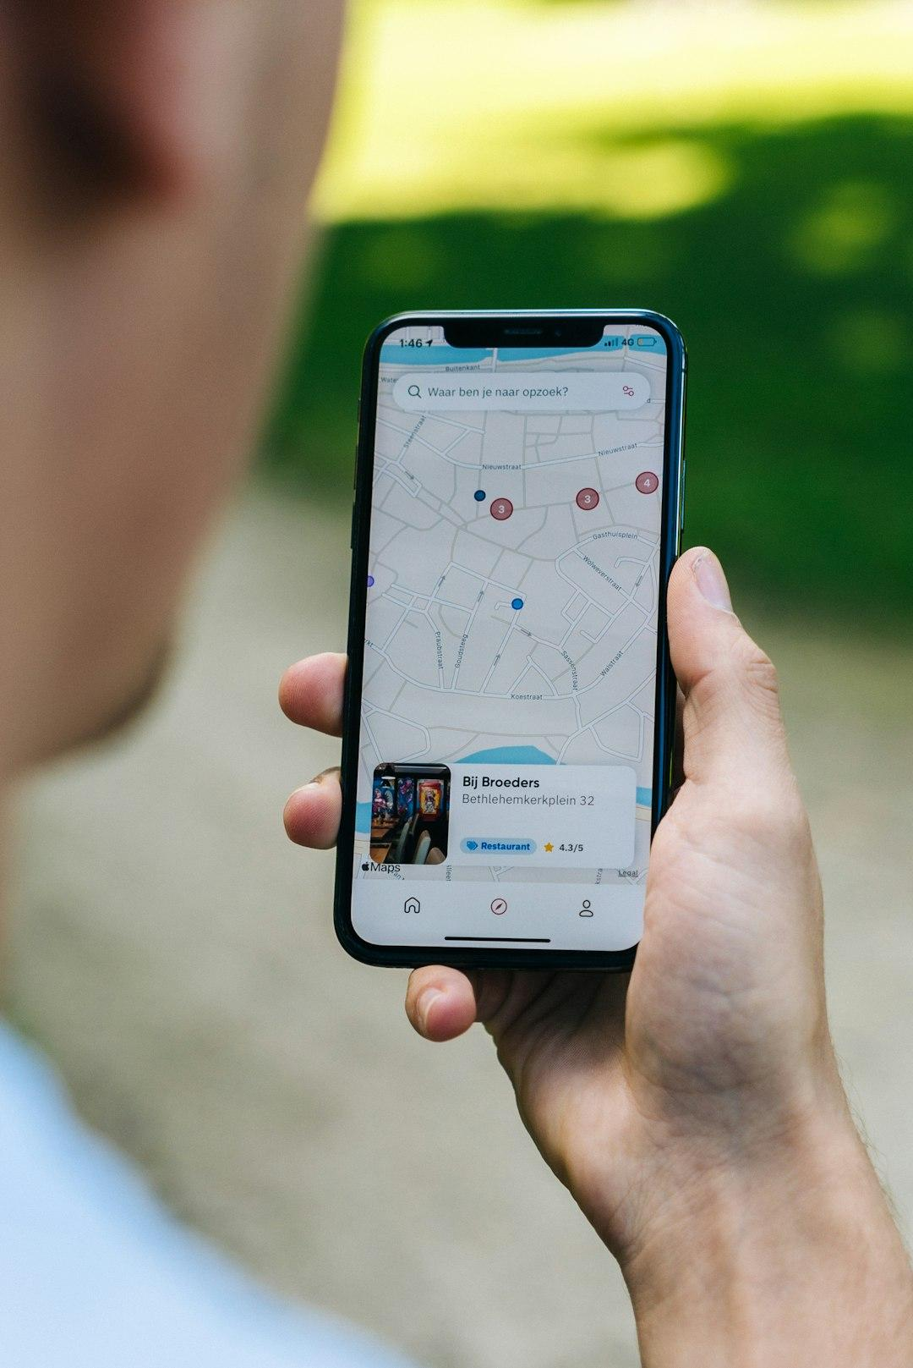
PRODUCT
INTRODUCTION​
OUR SOLUTION
TO USE GENERATIVE AI TO PROVIDE REAL TIME RECOMMENDATIONS TO THE DRIVERS BY UNDERSTANDING BEHAVIOR’S PATTERNS
WITHOUT OUR SOLUTION
WITH OUR SOLUTION
UNAIDED & UNSAFE DRIVING EXPERIENCE
SAFER DRIVING EXPERIENCE
CONTINUED GROWTH OF COLLISIONS
LOWER COLLISIONS BY 15%
HIGHER COSTS TO THE CITY
LOWER COST TO THE CITY
GENERATIVE AI FOR REAL-TIME RECOMMENDATIONS AIMS TO
CREATE A SAFER DRIVING EXPERIENCE BY LEVERAGING DATA TO GUIDE DRIVERS IN MAKING INFORMED CHOICES ON THE ROAD

Slide 9
PRODUCT
INTRODUCTION​
OUR SOLUTION
TO USE GENERATIVE AI TO PROVIDE REAL TIME RECOMMENDATIONS TO THE DRIVERS BY UNDERSTANDING BEHAVIOR'S PATTERNS
WITHOUT OUR SOLUTION
WITHOUT OUR SOLUTION
WITH OUR SOLUTION
UNAIDED & UNSAFE DRIVING EXPERIENCE
UNAIDED & UNSAFE DRIVING EXPERIENCE
SAFER DRIVING EXPERIENCE
CONTINUED GROWTH OF COLLISIONS
LOWER COLLISIONS BY 15%
CONTINUED GROWTH OF COLLISIONS
HIGHER COSTS TO THE CITY
LOWER COST TO THE CITY
HIGHER COSTS TO THE CITY
GENERATIVE AI FOR REAL-TIME RECOMMENDATIONS AIMS TO
CREATE A SAFER DRIVING EXPERIENCE BY LEVERAGING DATA TO GUIDE DRIVERS IN MAKING INFORMED CHOICES ON THE ROAD

Slide 10
PRODUCT
INTRODUCTION​
OUR SOLUTION
TO USE GENERATIVE AI TO PROVIDE REAL TIME RECOMMENDATIONS TO THE DRIVERS BY UNDERSTANDING BEHAVIOR'S PATTERNS
WITHOUT OUR SOLUTION
WITH OUR SOLUTION
UNAIDED & UNSAFE DRIVING EXPERIENCE
SAFER DRIVING EXPERIENCE
SAFER DRIVING EXPERIENCE
LOWER COLLISIONS BY 15%
CONTINUED GROWTH OF COLLISIONS
LOWER COLLISIONS BY 15%
HIGHER COSTS TO THE CITY
LOWER COST TO THE CITY
LOWER COST TO THE CITY
GENERATIVE AI FOR REAL-TIME RECOMMENDATIONS AIMS TO
CREATE A SAFER DRIVING EXPERIENCE BY LEVERAGING DATA TO GUIDE DRIVERS IN MAKING INFORMED CHOICES ON THE ROAD

Slide 11
PRODUCT
INTRODUCTION​
OUR SOLUTION
TO USE GENERATIVE AI TO PROVIDE REAL TIME RECOMMENDATIONS TO THE DRIVERS BY UNDERSTANDING BEHAVIOR'S PATTERNS
WITHOUT OUR SOLUTION
WITH OUR SOLUTION
BY HARNESSING THE POWER OF CUTTING-EDGE AI, OUR GOAL IS TO ENSURE SAFER JOURNEYS AND EMPOWER EVERY STAKEHOLDER WITH THE CONFIDENCE TO MAKE INFORMED DECISIONS.
UNAIDED & UNSAFE DRIVING EXPERIENCE
SAFER DRIVING EXPERIENCE
CONTINUED GROWTH OF COLLISIONS
LOWER COLLISIONS BY 15%
HIGHER COSTS TO THE CITY
LOWER COST TO THE CITY
GENERATIVE AI FOR REAL-TIME RECOMMENDATIONS AIMS TO
CREATE A SAFER DRIVING EXPERIENCE BY LEVERAGING DATA TO GUIDE DRIVERS IN MAKING INFORMED CHOICES ON THE ROAD

Slide 12
HOW DOES IT WORK?

Slide 13





HOW DOES IT WORK?
DETECTION BY GEN AI
{ACCELERATION:NORMAL, SPEEDING: 73%, MOBILE USAGE: HIGH, AVERAGE TRAVEL TIME: 50 MIN..}
Provides a personalized recommendation on time
BEHAVIOUR PATTERNS
ABOUT TO GO
INTO RED ZONE
RED ZONE
Safely navigate collision
prone zone
Zone with highest
number of High
Acceleration
collision
LLM MODEL
Information feedback
Generative AI

Slide 14
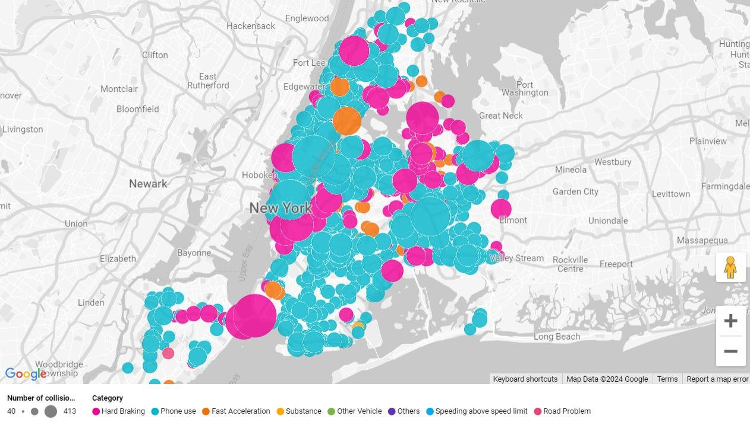

Slide 15
LET'S DIG A LITTLE DEEPER !

Slide 16
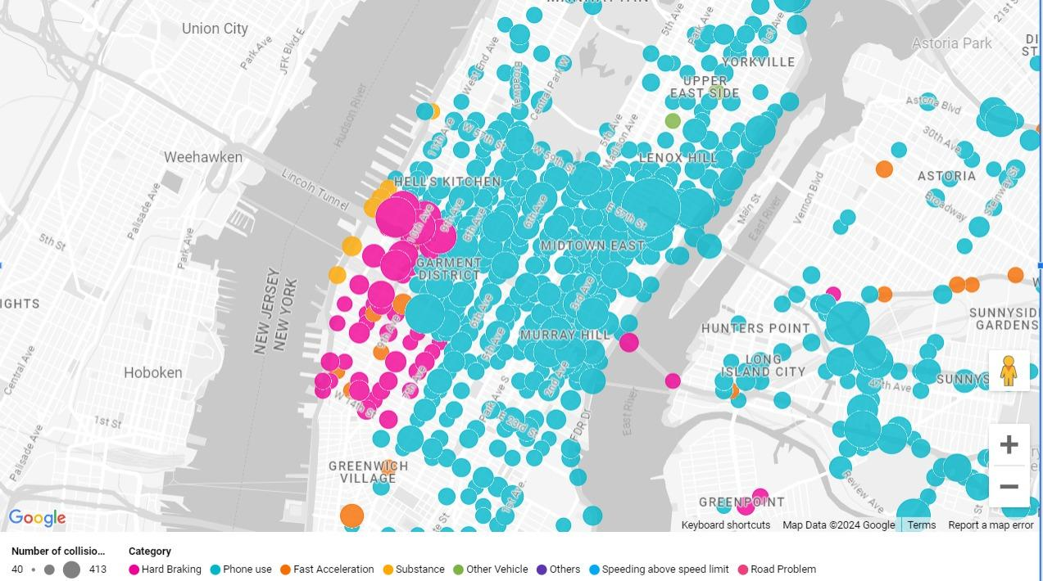

Slide 17
LET'S DIG EVEN DEEPER !!

Slide 18
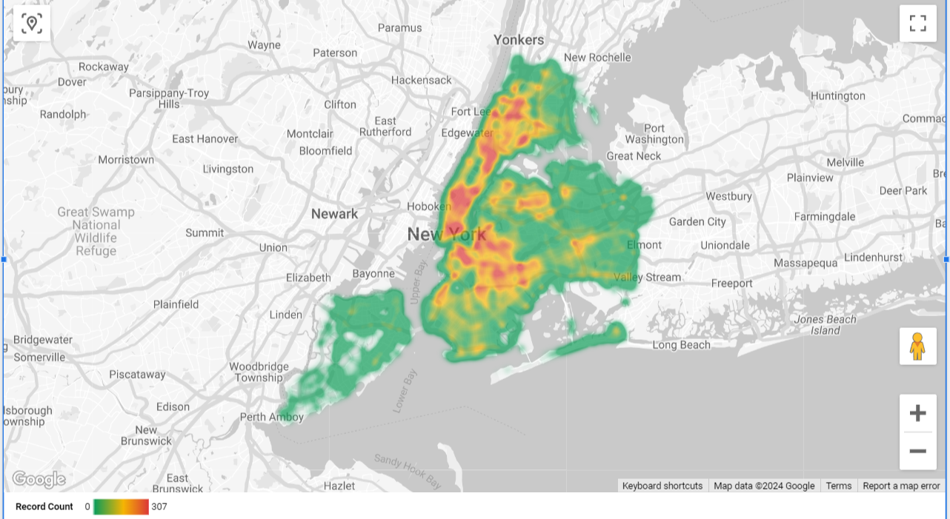
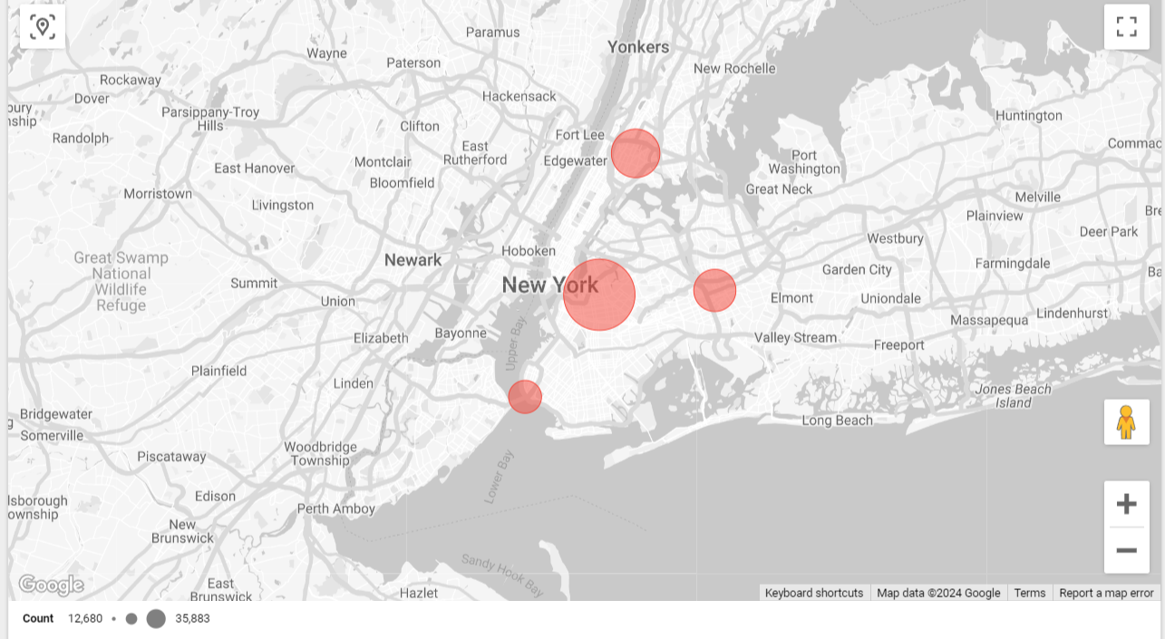
Clustering using K-means ML Algorithm
K
Clusters centers with highest collisions

Slide 19
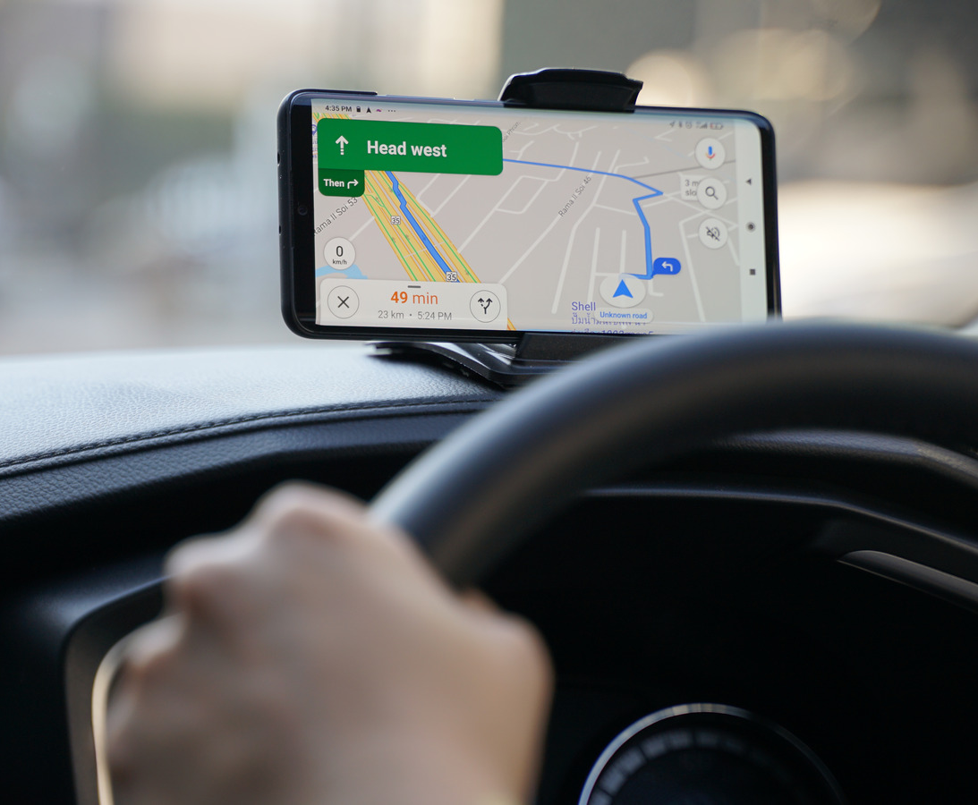

HOW GENERATIVE AI HELPS US ACHIEVE OUR GOAL?
OUR GENERTIVE AI
MODEL FEATURES
WHAT MAKES A GEN AI
MODEL GREAT?
Can provide recommendation in form text, image & audio
Generative Capacity
Can learn from pre-trained models
Transfer Learning
Iterative training process
Continuous Improvement
Provide real time recommendation to users
Real world Application

Slide 20
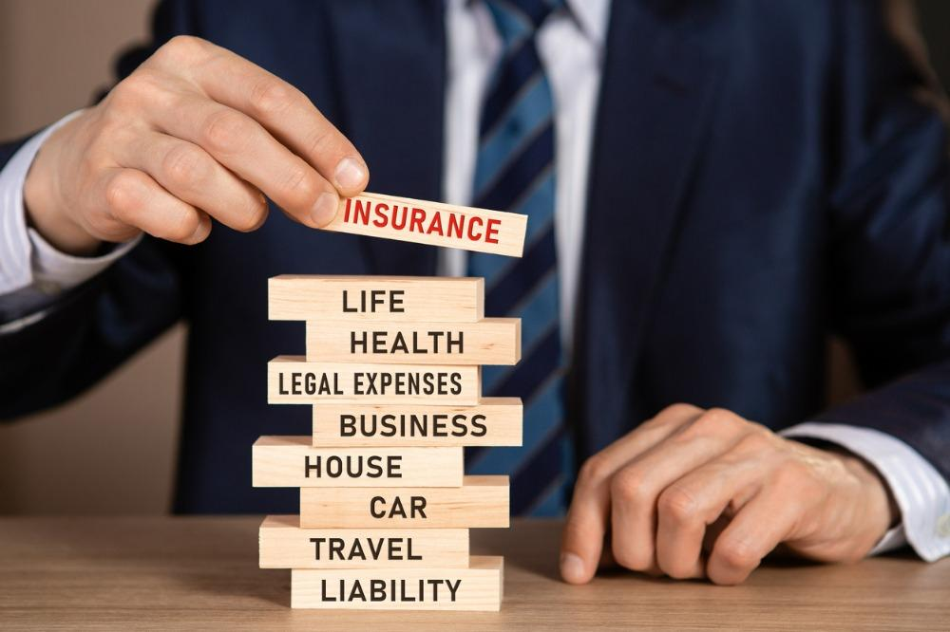

OTHER INDUSTRIES WE WANT TO IMPACT
INSURANCE
CIVIC BODIES

Slide 21

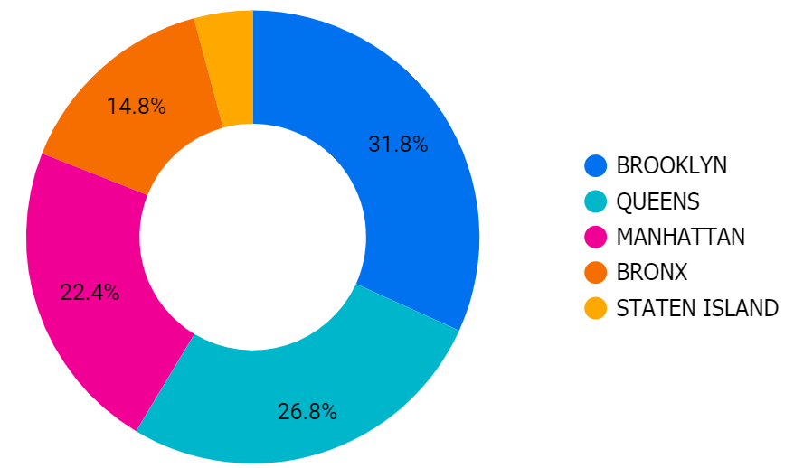
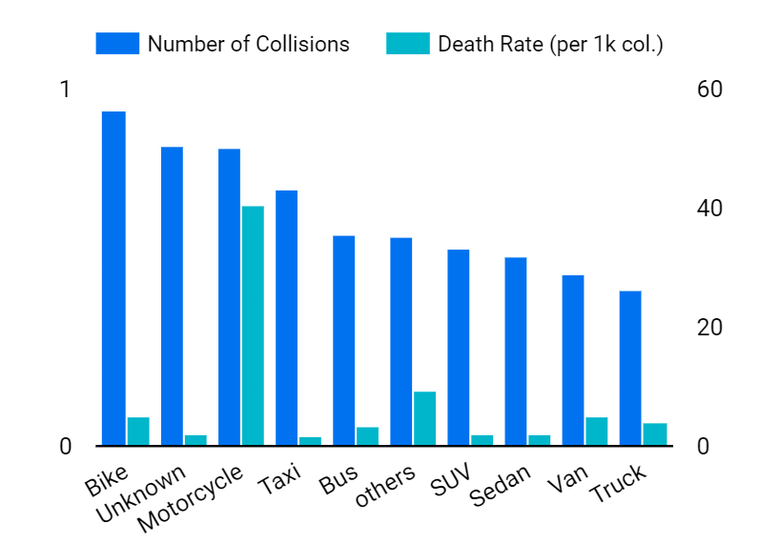
HOW CAN WE HELP THE INSURANCE COMPANIES?
Just to give a few examples….
Zonal Risk Assessments to decide on
regional insurance rates
Safety Assessment for different
Car Models

Slide 22
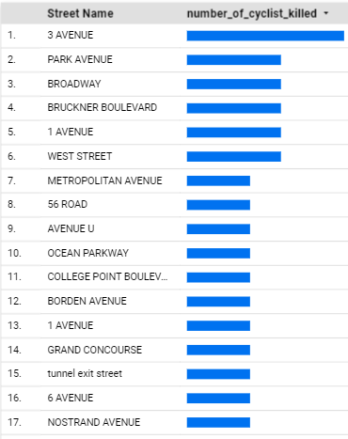

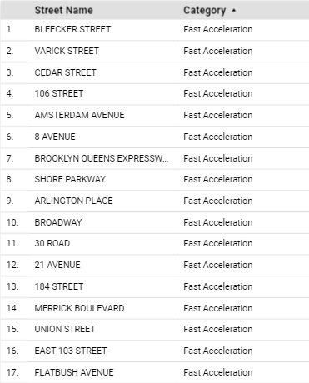
HOW WE PLAN TO HELP THE CIVIC BODIES?
Identify high risk zones & roads
INSTALL STOP SIGNS OR WARNINGS
INSTALL SPEED BUMPS
Identify streets with speeding cases
INSTALL SPEED DETECTION CAMERAS
Identify high risk areas for bikers
INSTALL BIKE LANES
Patrol roads lacking safety

Slide 23

ARCHITECTURE
Data ingestion
Data Extraction
GEN AI LLM MODEL 1
LLM MODEL 2
LLM MODEL 3
LLM MODEL N
…
Behaviour Patterns
Recommendations
Action
USER 2
USER 3
USER N

Slide 24



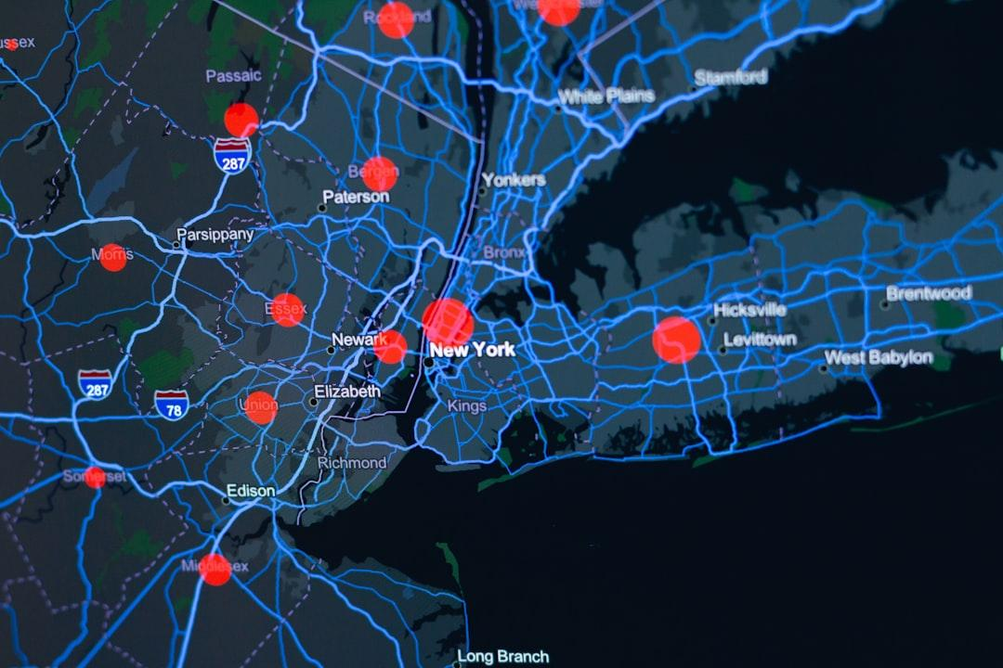


IMPLEMENTATION
DATA COLLECTION
COLLABORATION WITH GOVT
INTEGRATION WITH GOOGLE MAPS
Speeding
Rapid Acceleration
Hard braking
Phone use
Time & location

Slide 25
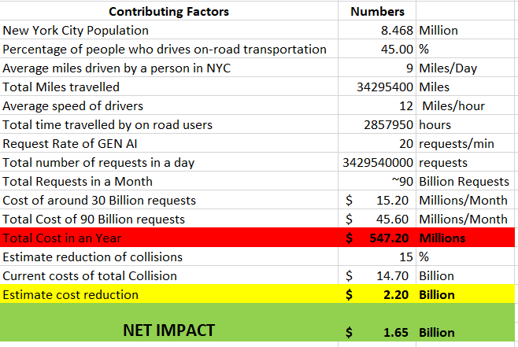



COST BENEFIT ANALYSIS
Statistic Sources: NYC green dividend
report & NYC mobility report 2022
Google's Cloud pricing calculator
MODEL:

Slide 26
CONCLUSION
WITH OUR SOLUTION
Takes a route
with Red zones
Bolstering the view of Vision Zero:
Designing the system to accommodate the variability of Human Error
Drives to
her School
Tend to take
sharp turns
"Now I have a safer Experience "
Gets a personalized recommendation
"Now I can make better decision to set Risk premiums" ~Insurance agent
Gets to NYU
safely
Doesn't take
sharp turn
" Now I can optimize my workforce across the City"
~City planning committee

Slide 27
APPENDIX

Slide 28
2024 Hackathon Challenges Answers
Q1: What boroughs of New York see the most collisions? Are there any areas of the city or intersections with a high number of collisions?
A1: Brooklyn
Q2 What were the biggest primary and secondary contributing factors for motor vehicle collisions?
A2: Phone use: Driver Inattention/Distraction, Failure to yield right of way
Q3 Does the type of vehicles involved in collisions have an impact on the rate of injury/death?
A3: No, there is no direct relation of vehicle involved in collision with injury/death rate. From our analysis we see SUVs and Sedan are involved in most number of collision, however the number of rate of injuries and death rate are higher for bike and motorcycle
Q4 Are injuries and deaths declining as expected by Vision Zero? Are there any seasonal, weekly, or daily patterns to the number of collisions?
A4: There was a noticeable but not highly significant drop after Vision Zero was implemented, followed by another spike in 2021.
In the seasonal analysis for 2023, the second quarter recorded the highest collision rates, while the fourth quarter witnessed the highest death rates. Breaking down the monthly trends in 2023, August stood out with the peak in death rates. The period from May to October consistently showed elevated rates, with relatively lower figures for January and February. Looking at the overall monthly data, May exhibited the highest rates.In the weekly analysis for 2023, Fridays experienced the highest collision rates, while Sundays recorded the lowest. Examining the 24-hour pattern for 2023, collisions peaked during the morning commute at 8 am and decreased after 5 pm.
Q5 How do injuries and death rates differ between pedestrians, motorists and cyclists?
A5: Cyclist- a) Injury Rate: Stable with minor fluctuations, a slight peak in 2019, then returns to the baseline. b) Death rate: Low and stable with slight variations, no clear trend over the years
Motorist- a) Injury Rate: Initially higher than cyclists in 2014, decreases significantly until 2017, and slightly increases by 2023. b) Death Rate: Fluctuates, peaks around 2019, then returns closer to earlier levels. Pedestrian- a) Injury Rate: Starts lowest in 2014, steadily increases, surpasses motorist rate by 2018, highest by 2023. b) Death Rate: Starts as the highest, maintains that position, with a slight upward trend.

Slide 29
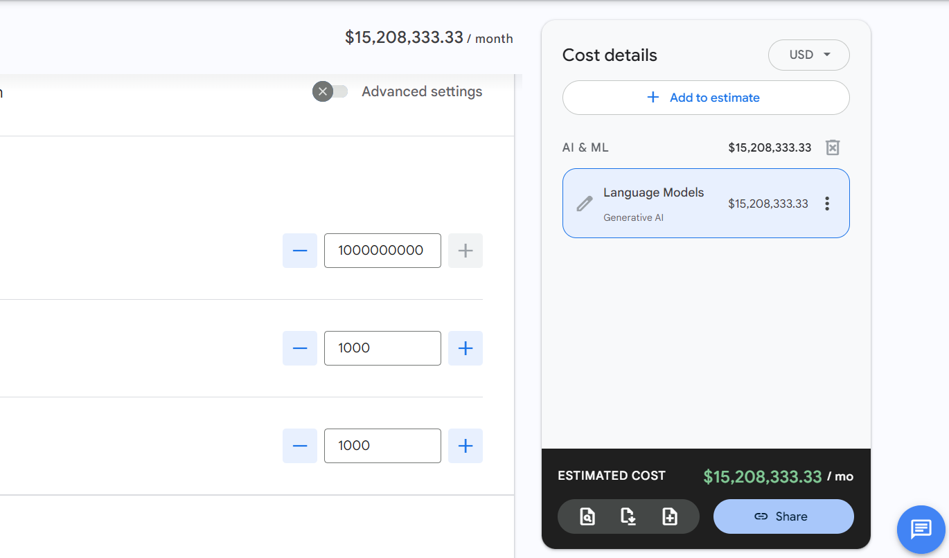
PRICING FOR MONTH

Slide 30
REFERENCES
https://www.sciencedirect.com/science/article/abs/pii/S0001457514003728- Study Showing immediate personalized recommendation can estimate to reduce collisions by 15 percent
https://www.sciencedirect.com/science/article/abs/pii/S0968090X22002029
https://www.nyc.gov/html/dot/downloads/pdf/nyc_greendividend_april2010.pdf- NYC green dividend report
https://s3-us-west-2.amazonaws.com/zd-website-assets/casestudies/NYU+Zendrive+data+review+-+May2017.pdf

Slide 31
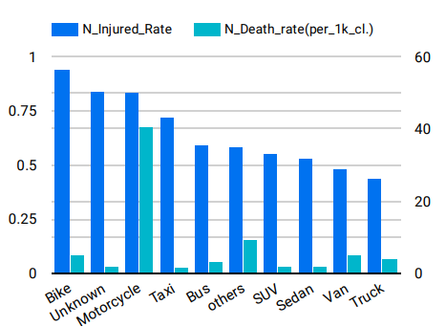
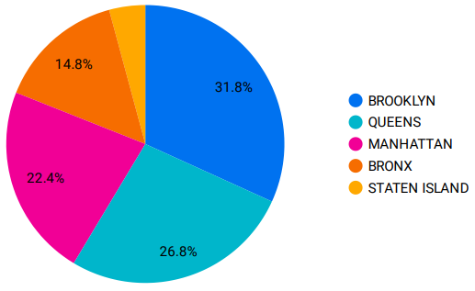
HOW CAN WE HELP THE INSURANCE
COMPANIES ?
Zonal Risk Assessments to decide
on regional insurance rates
Safety Assessment for different
Car Models
Interactive dashboards to take
decisions better

